Slide 1

MongolZ
Online banking system
2018

Slide 2



Team members
Name: Enkhtulga Tseveenkhuu (Eta)
Student id: 986215
Nationality: Mongolia
Name: Munkhdelger Buyandalai (Deegii)
Student id: 986402
Nationality: Mongolia
Name: Enkhbayar Sambuu-Yondon (Enkhee)
Student id: 986369
Nationality: Mongolia

Slide 3
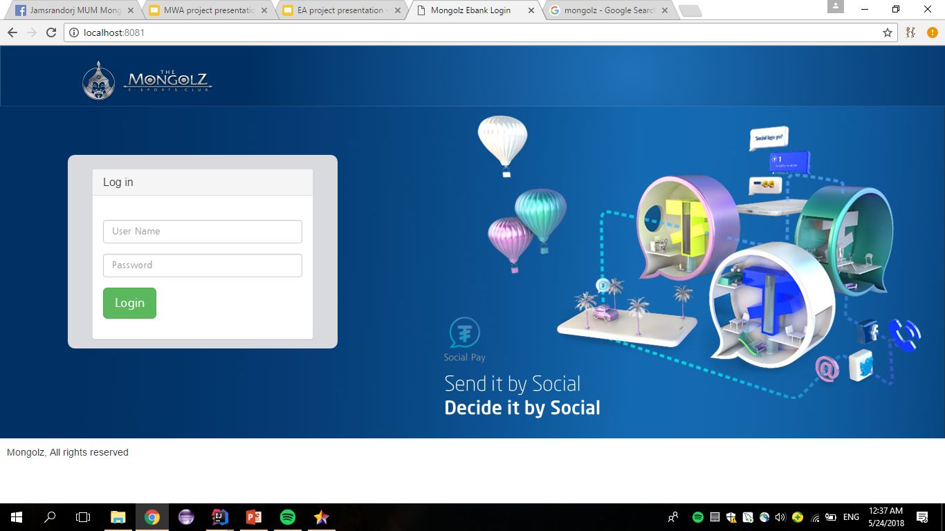
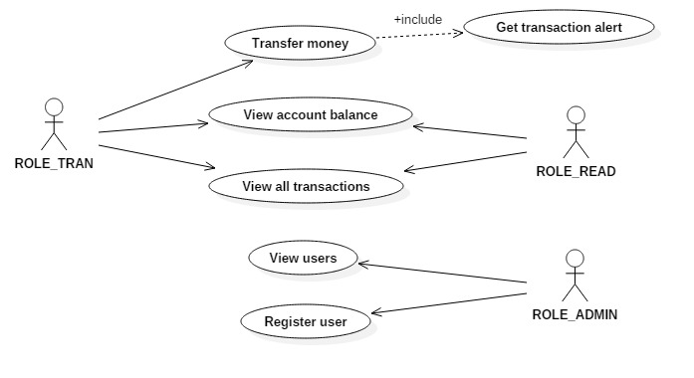
Mongolz ebank
User (transaction)
View Account Balance
View all transaction
Transfer money
Get transaction alert
User (read)
View Account Balance
View all transaction
Admin
View users
Register user

Slide 4
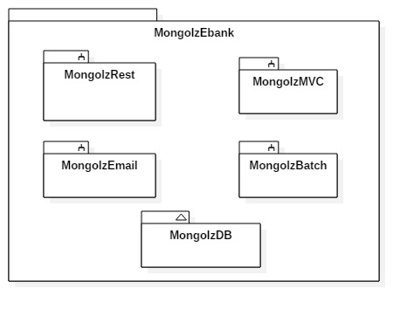
Components

Slide 5
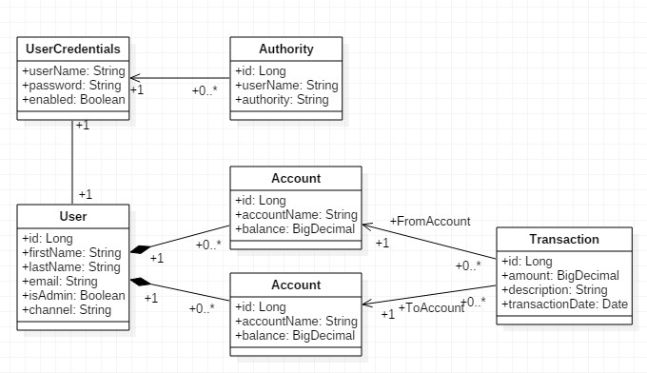
Class diagram

Slide 6




WHAT dID WE use?
RESTful web service
Spring MVC
Hibernate
AOP
EAI
Email
REST security
Security
Maven
Batch
Online SVN repo /Github/

Slide 7
Our tASKS
Eta
Enkhee
Deegii
Account
Transaction
Restful web service
AOP
Validation
MVC
Front end
EAI
Batch
Email
User
Security
Rest security
Validation
Fetch

Slide 8
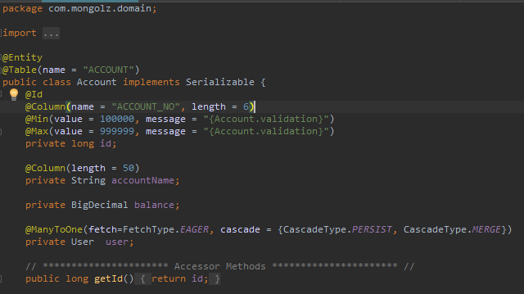
Code example
Validation
Hibernate
Annotation driven

Slide 9
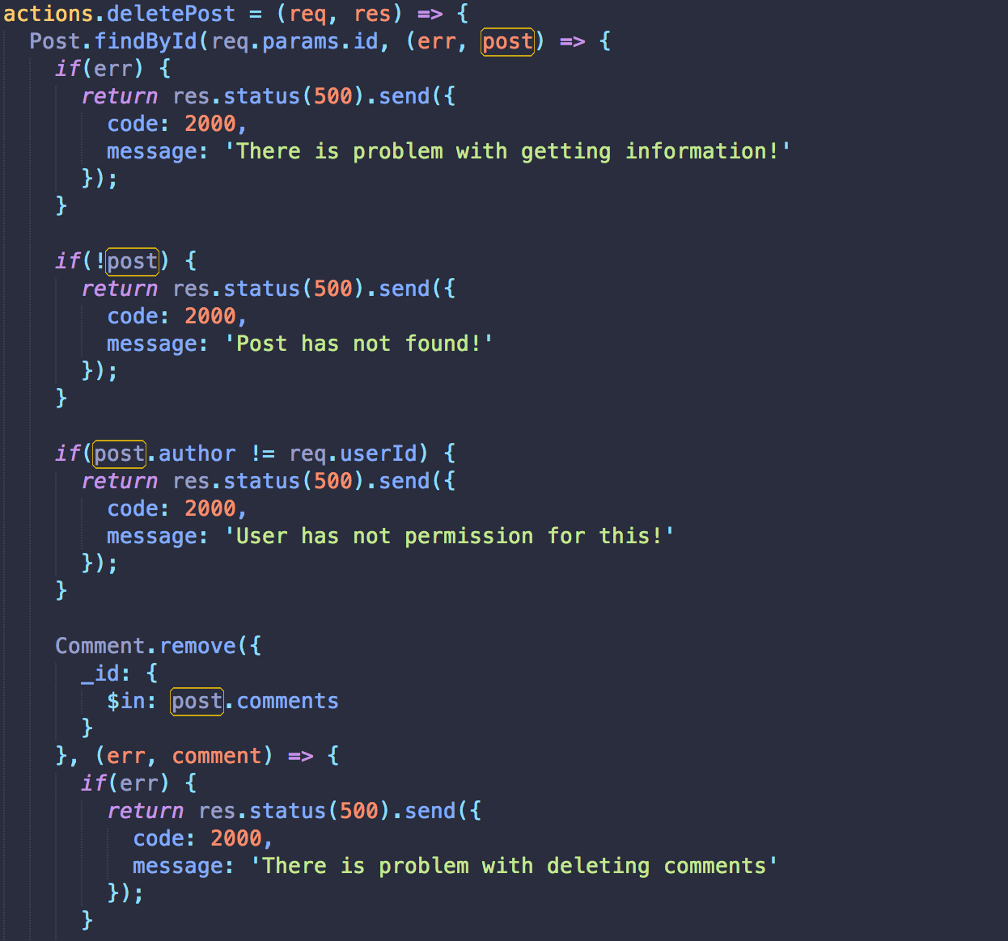
EAI

Slide 10
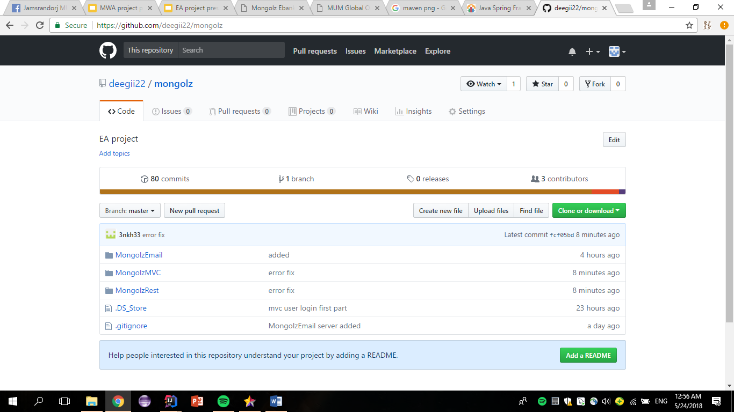
Our development process
https://github.com/deegii22/mongolz

Slide 11
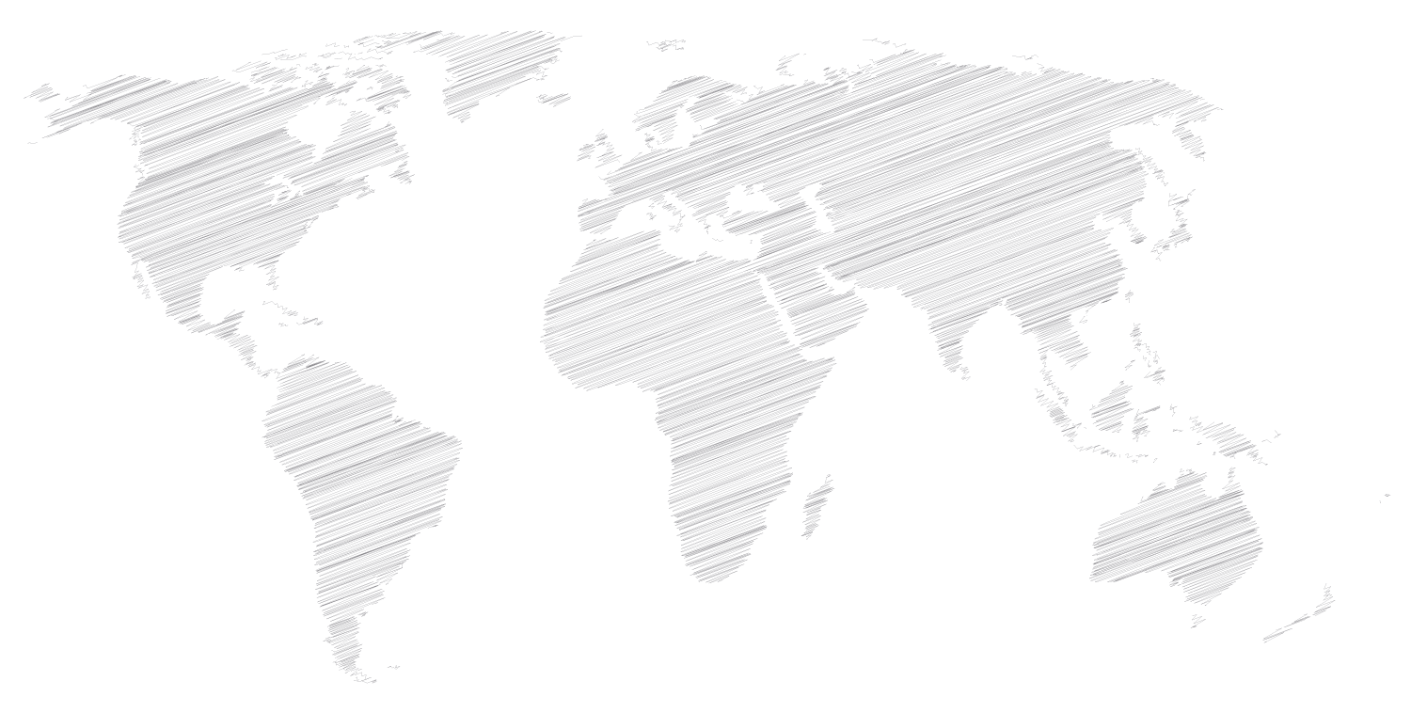
Maps
our office
Fairfield,IA

Slide 12


Thank you for
your attention.

